Slide 1
USS 2020 valuation What does it mean for us?
Neil M Davies
neil.davies@Bristol.ac.uk
@nm_davies
20/05/2021
https://github.com/nmdavies/oxford_uss_ucu_talk/

Slide 2
Outline
What does it mean for me?
UUK proposals
The 2020 valuation
What do we want?
Governance reform
A credible valuation
How do we get it?
Legal action
Industrial action
Questions, discussion

Slide 3
UUK’s proposals
So based on USS proposals for a non-statutory 2020 valuation UU
Proposed reform of the scheme - benefit cuts!
Current
DB income threshold: £60,000
Accrual rate: 1/75th
Inflation protection cap 5% + 50% of increases between 5% and 15%
Proposed
Drop contribution increase to 11%/23.7% scheduled for October
Option A | Option B
DB income threshold: £40,000 | DB income threshold: £30,000
Accrual rate: 1/85th | Accrual rate: 1/75th
Inflation protection cap 2.5% | Inflation protection cap 2.5%
https://www.ussemployers.org.uk/briefings/uuk-launches-consultation-indicative-outcomes-2020-uss-valuation

Slide 4
What does this mean for me?
Go here:
http://uss-pension-model.com
It calculates forecast income under the USS’s assumptions
Gives the two options presented by UUK
Models the impact of inflation

Slide 5
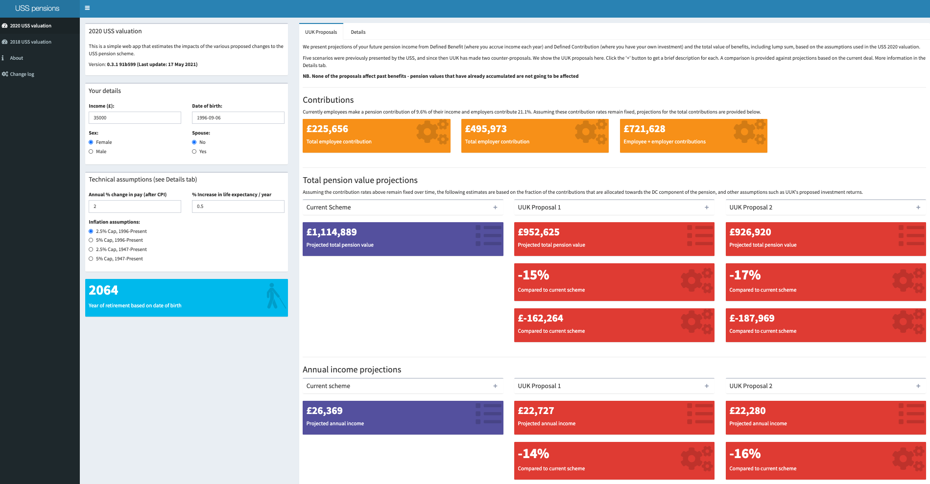

Slide 11
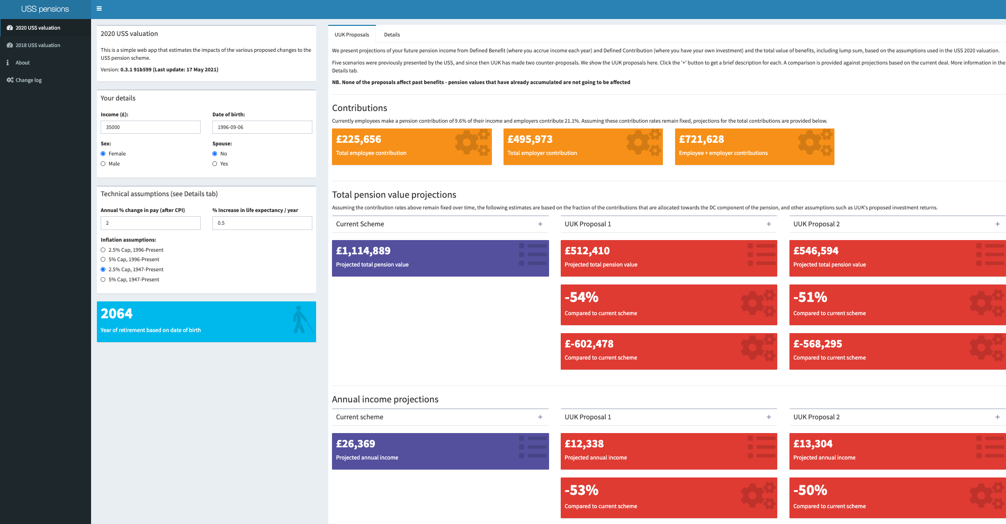

Slide 12
The USS 2020 valuation
Are these changes justified?
The USS claims:
Assets as of 30th March 2020 = £66.5bn
Liabilities (our pensions) = £76.3 to £84.4bn
Deficit = £9.8 to £17.9bn
These are big numbers
However, these claims are based on extremely dubious analysis…

Slide 13
Problems with the valuation
Timing
Prudence
Projected investment returns
The law
Governance

Slide 14
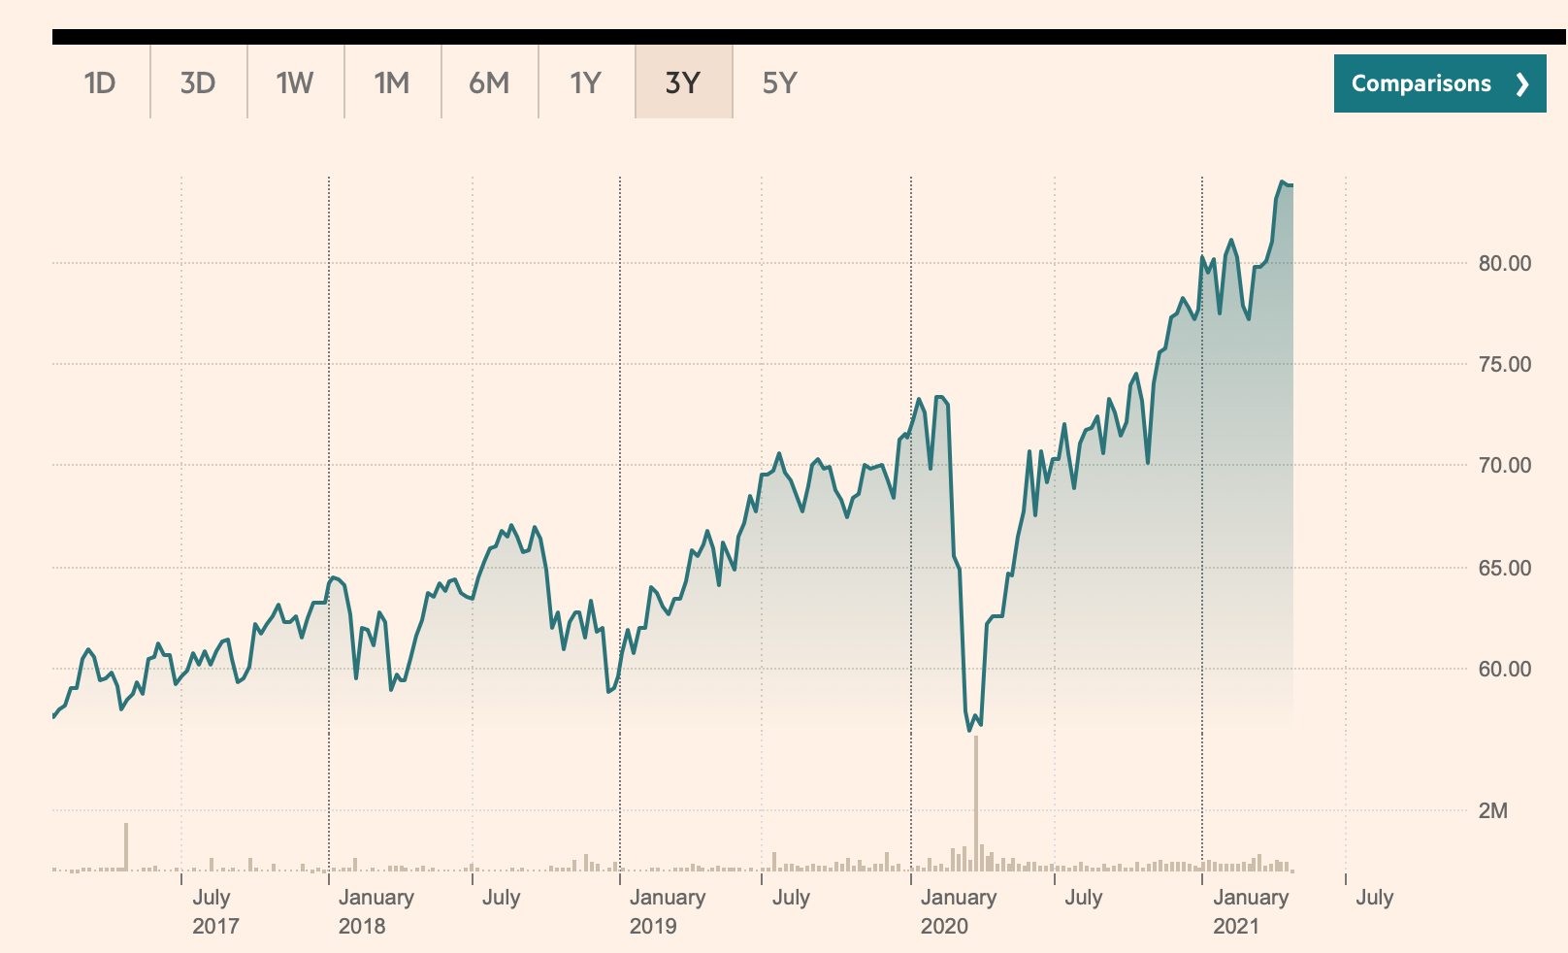
Problems with the valuation: 1 Timing
+40%
USS chose to conduct a valuation here
-20%
https://markets.ft.com/data/etfs/tearsheet/historical?s=VWRL:LSE:GBP

Slide 15
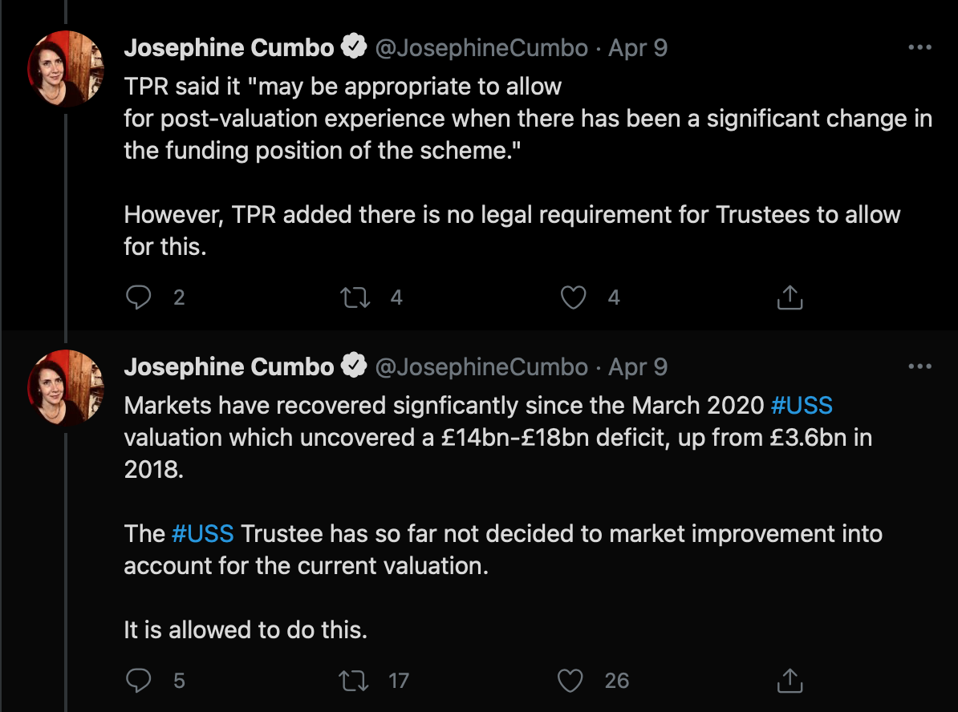
Problems with the valuation: 1 Timing
+40%
USS chose to conduct a valuation here
-20%
https://markets.ft.com/data/etfs/tearsheet/historical?s=VWRL:LSE:GBP

Slide 16
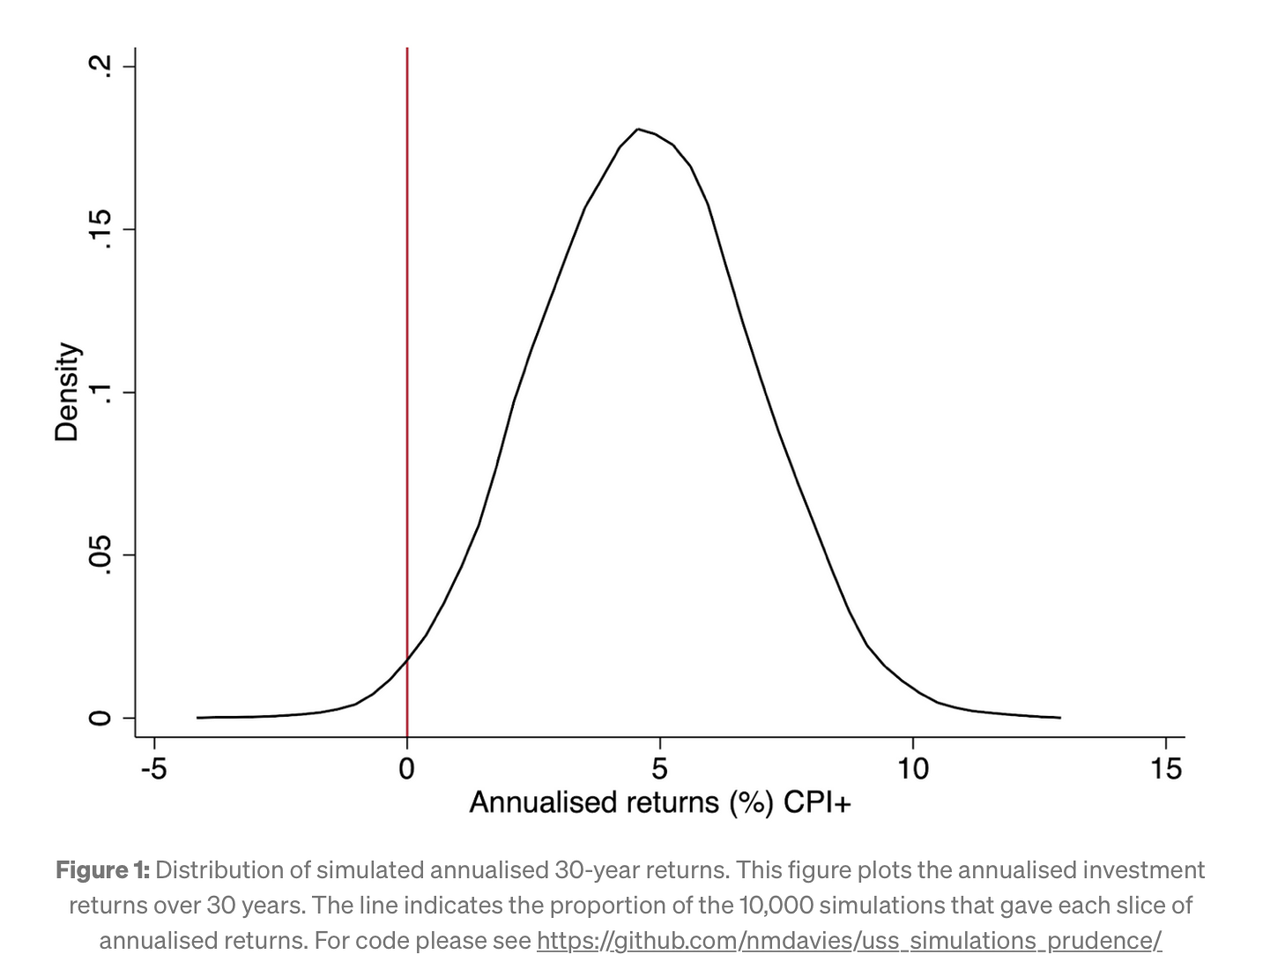
Problems with the valuation: 2 “the level of prudence”
USS proposes increasing prudence
2018 =67%
2020 =82% to 86%
Why does this matter?
Higher prudence means
Lower projected investment returns
Higher costs
Larger deficit
USS Chair of Trustees, Kate Barker called this a qualitative judgement call
Davies (2021) https://medium.com/ussbriefs/the-usss-prudence-evidence-based-or-reverse-engineered-2da7ca1e5d64

Slide 17
Problems with the valuation: 2 “the level of prudence”
Valid statistical analysis:
Sets assumptions
Runs analysis
Interprets results
It is possible to reverse this process…
Reverse engineering results in this way would be considered fraudulent for a scientific paper.
USS appears to have set its assumptions to achieve a given discount rate - after pressure from TPR
Davies (2021) https://medium.com/ussbriefs/the-usss-prudence-evidence-based-or-reverse-engineered-2da7ca1e5d64

Slide 18
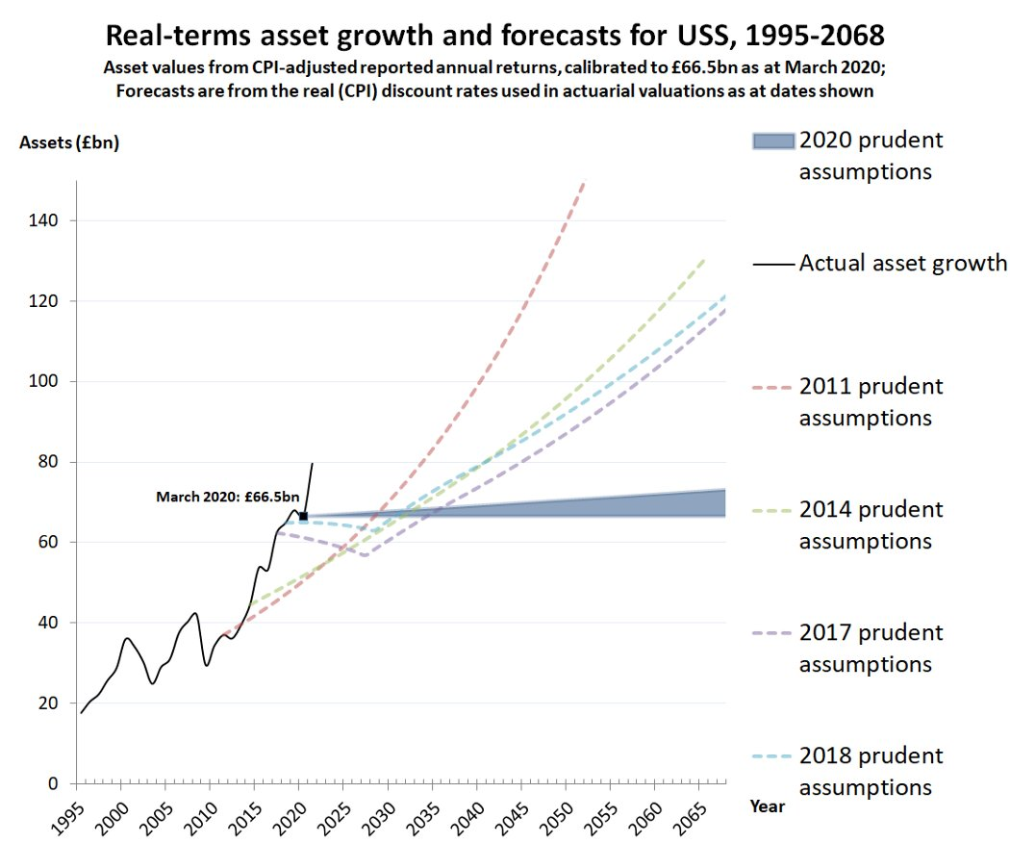
Problems with the valuation: 3 projected investment returns
Despite pandemic investment returns have been good.
USS beat forecasts at previous valuation
2020 valuation investment forecast
Most optimistic (0.2%) = out by 81 years!
USS claims “increases in asset values are irrelevant because future returns have now fallen” which is:
A. unsupported by evidence
B. unsupported by economic theory
i.e. entirely ad hoc
Marsh and Jackie (2021)
https://twitter.com/Sam_Marsh101/status/1374403388910145540?s=20

Slide 19

Problems with the valuation: 4 The Law
Leading pensions QC gave the following opinion wrt the 2017 valuation:
“Good grounds to take USS […] to court based on breach of trust”
The process underlying the 2020 valuation may be (likely) worse
http://uss-justice.org/2019/10/04/qc-opinion-there-are-good-grounds-to-take-uss-ltd-to-court/
Notes:
Academics for Pensions Justice crowd funded £50,000

Slide 20
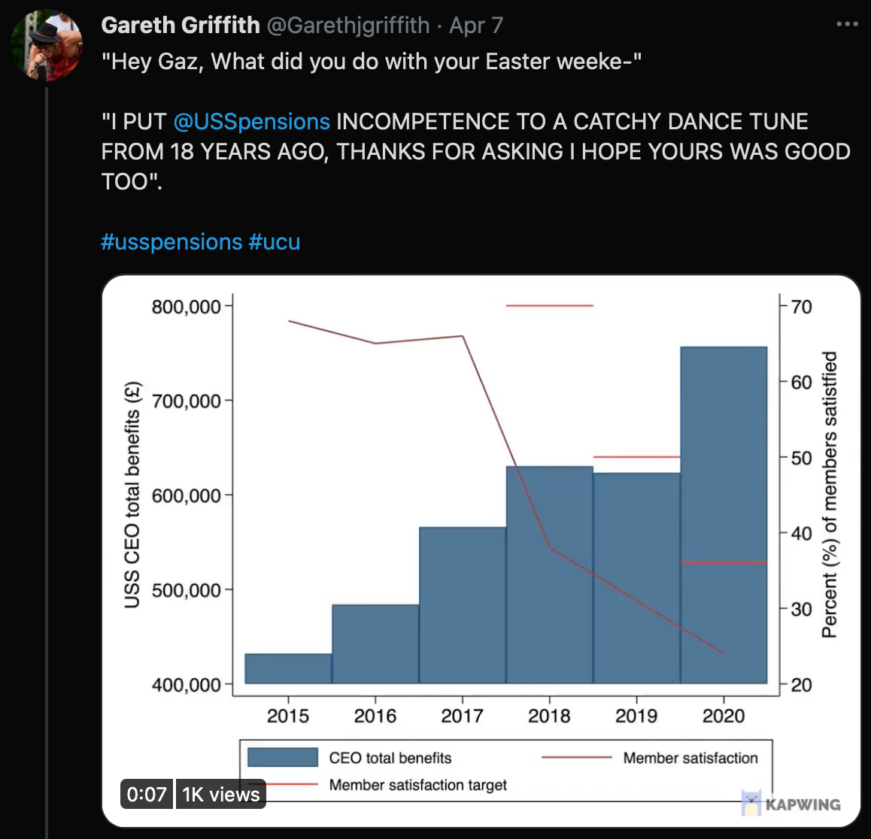
Problems with the valuation: 5 The Governance Crisis
No mechanism in the scheme rules for USS members to hold the USS account
Member consultations are ignored
90% of members responding to the 2018 valuation rejected the proposals, no changes were made)
Member satisfaction collapsed from 68% in 2014 to 24% in 2020
In response the USS Trustee repeatedly lowers its target for member satisfaction
https://www.hepi.ac.uk/2021/04/06/the-uss-trustees-governance-crisis/
Griffith (2021) https://twitter.com/i/status/1379502763823005696

Slide 21
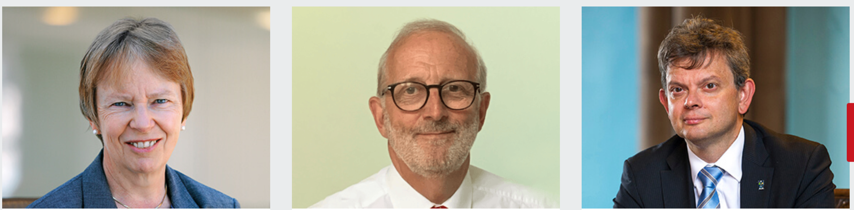

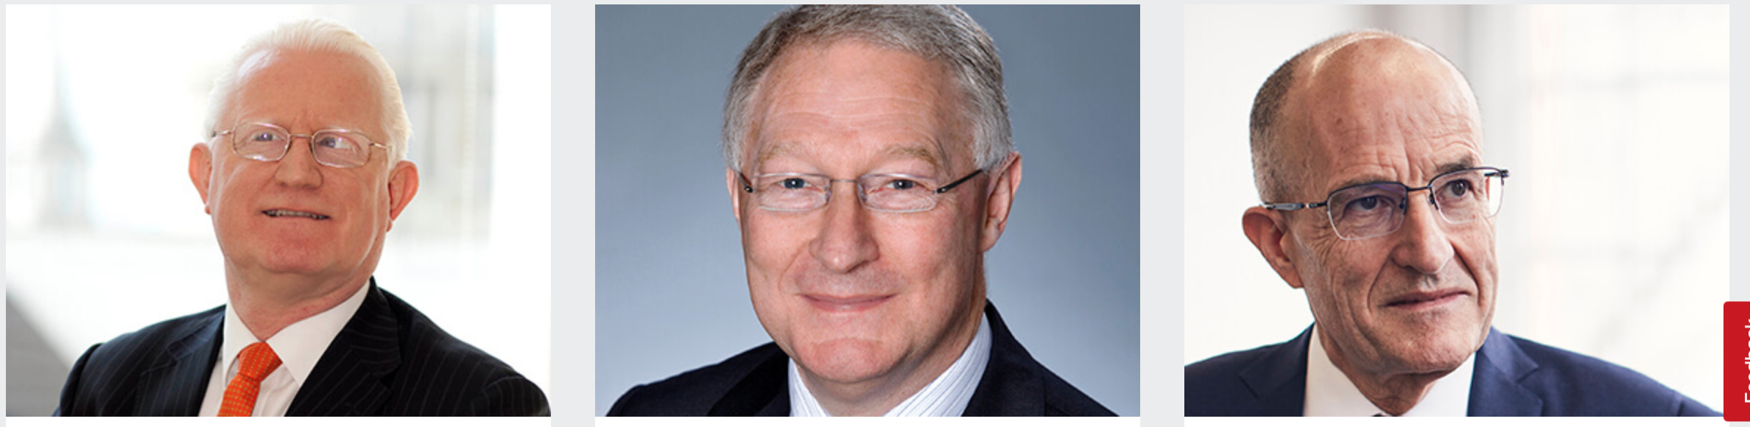
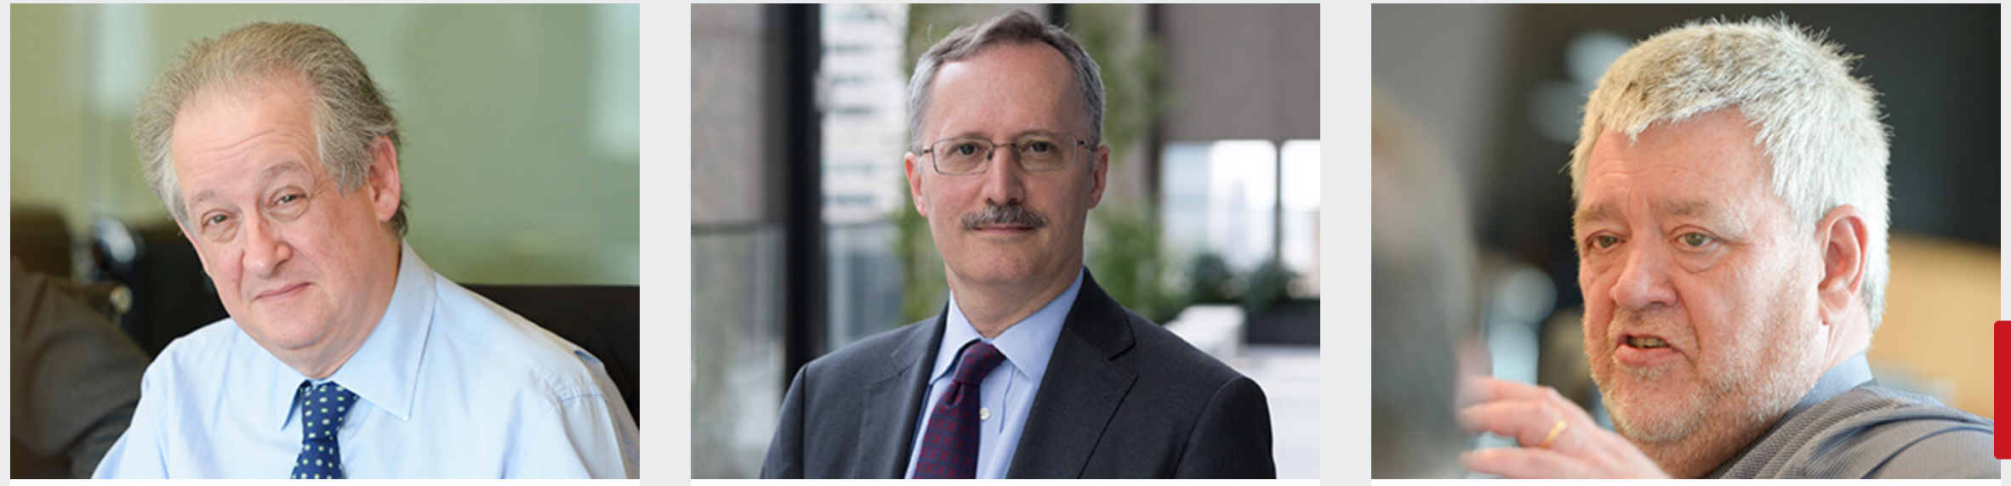
Who is responsible?
Your 12 USS Trustees
A diverse bunch including
Former employees of
HSBC
JP Morgan (*2)
Former central banker
Plus other financers
7 of 12 have little or no connection with HE
Only 5 work in HE
Failing to deliver for USS members
Members cannot hold them to account
https://www.uss.co.uk/about-us/how-were-governed/people/uss-board
Notes:
Stress this last point isn’t melodramatic – it’s *literally* the case!

Slide 22
Who can fix this?
The USS board of Trustees
UUK
UCU
The Pension Regulator
Most importantly all of us!

Slide 23
What do we want?
Governance reform
Fix USS governance by changing scheme rules
Joint Negotiating Committee can propose changes to the scheme rules:
Implement the changes to valuation governance proposed by the JEP2
Replace independent Trustees with employer/member nominated trustees
A credible valuation
Scrap the non-statutory 2020 valuation
Conduct a 2021 valuation
Keep prudence on investment returns at 67% centile as in 2018 (c£7bn-£10bn)
Update asset values (c£14bn)
These changes alone are far in excess of any estimated deficit
This is not hard to fix

Slide 24
How do we get it?
Talk to USS members
Legal action
Industrial action
Political action

